Slide 1
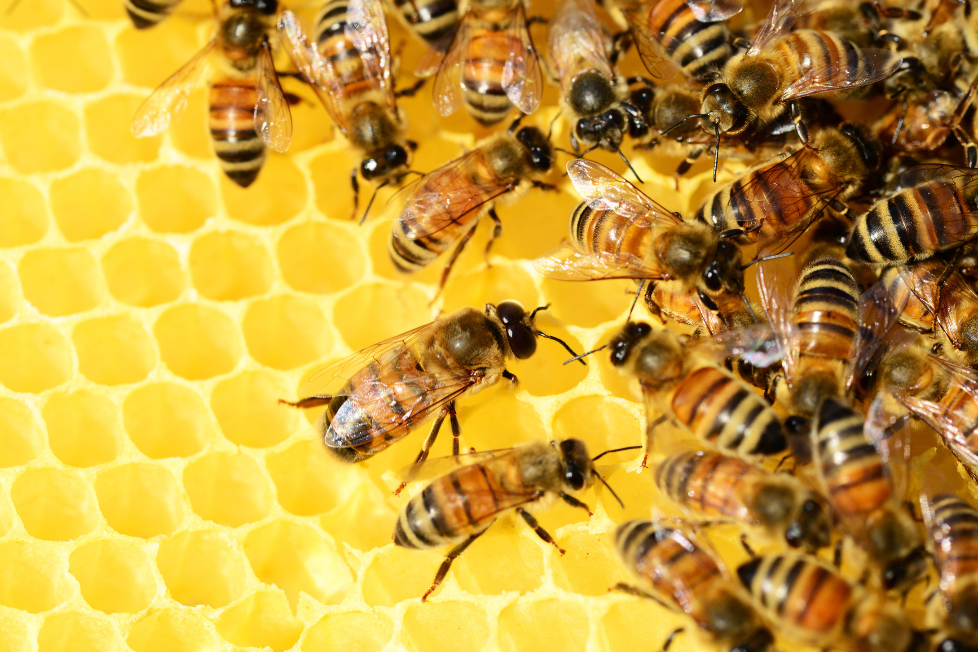


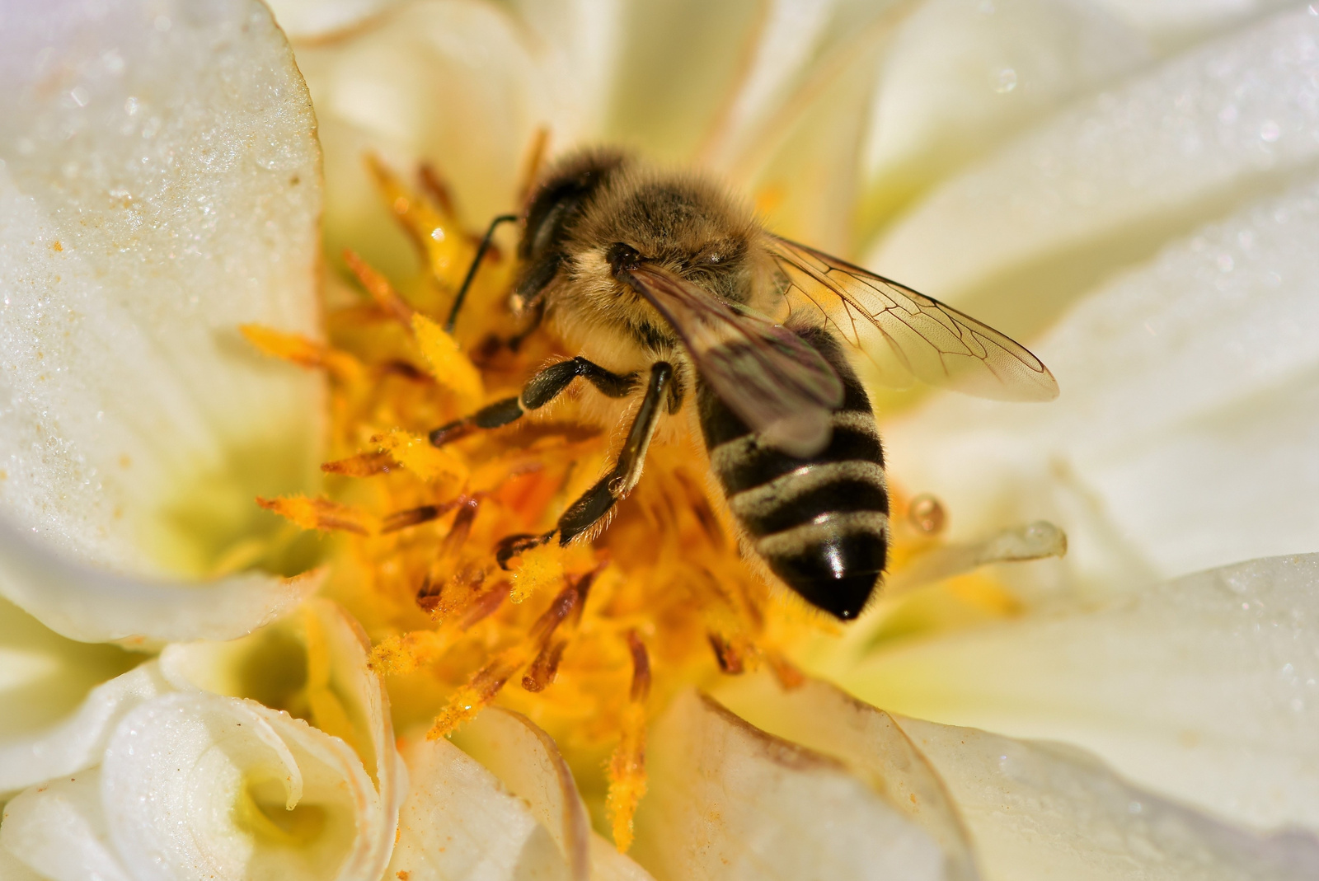
Jager ADS
an AI-Driven Beekeeping Assistant

Slide 2
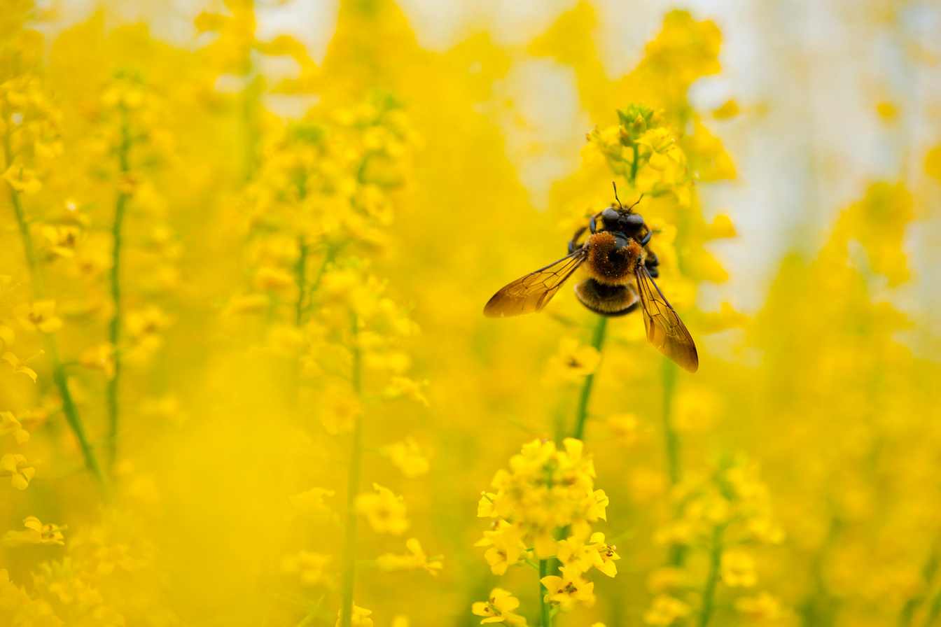
What is Jager ADS?
Jager ADS is an AI driven beekeeping assistant designed to help beekeepers monitor hive health and protect pollinators.
“Jager” means “hunter/enemy” in German
“ADS“
= Active Defense System

Slide 3
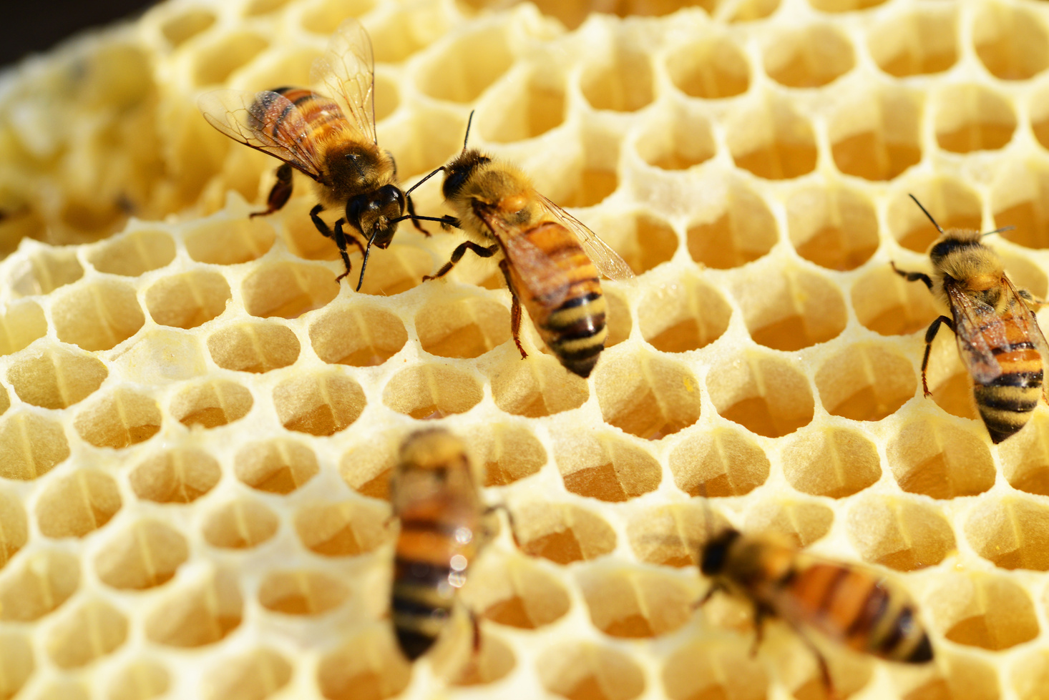
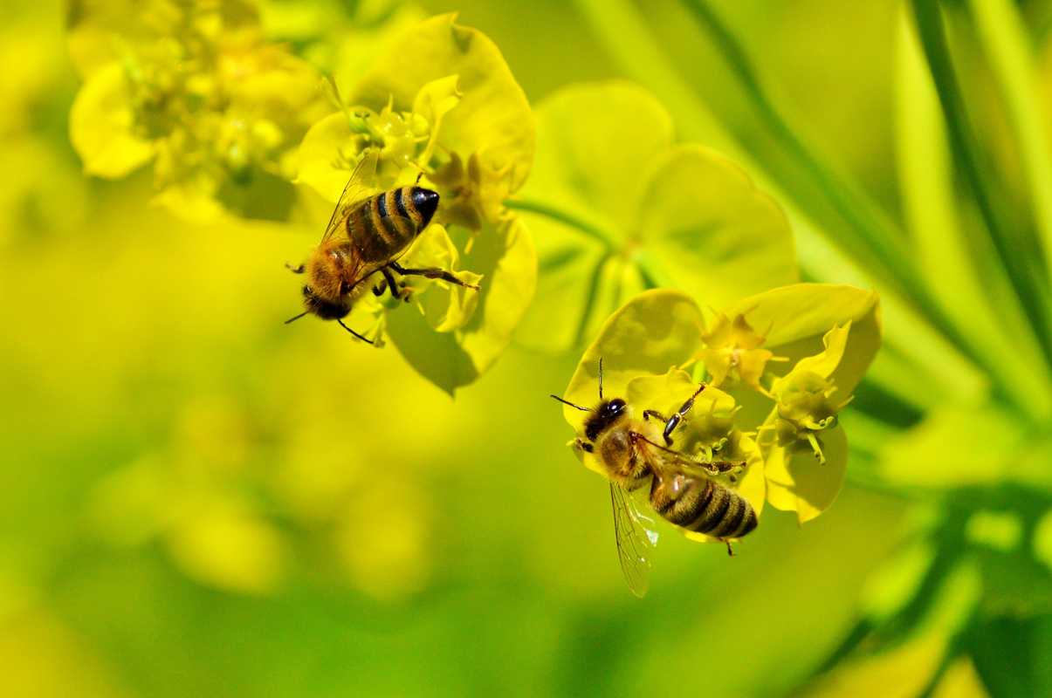
The Problem
Pollinators in Crisis
But bee populations are declining due to:
Climate change is disrupting flower cycles and habitats
Pesticide use is weakening bee immune systems
Invasive predators like hornets are destroying hives
Habitat destruction from urbanization and intensive farming
Bees are critical to global food production:
Why This Matters:
Declining bee populations threaten biodiversity, food security, and climate resilience. Protecting them means protecting ourselves.
75% of the world’s crops rely on insect pollination
1/3 of global food directly depends on bee activity

Slide 4
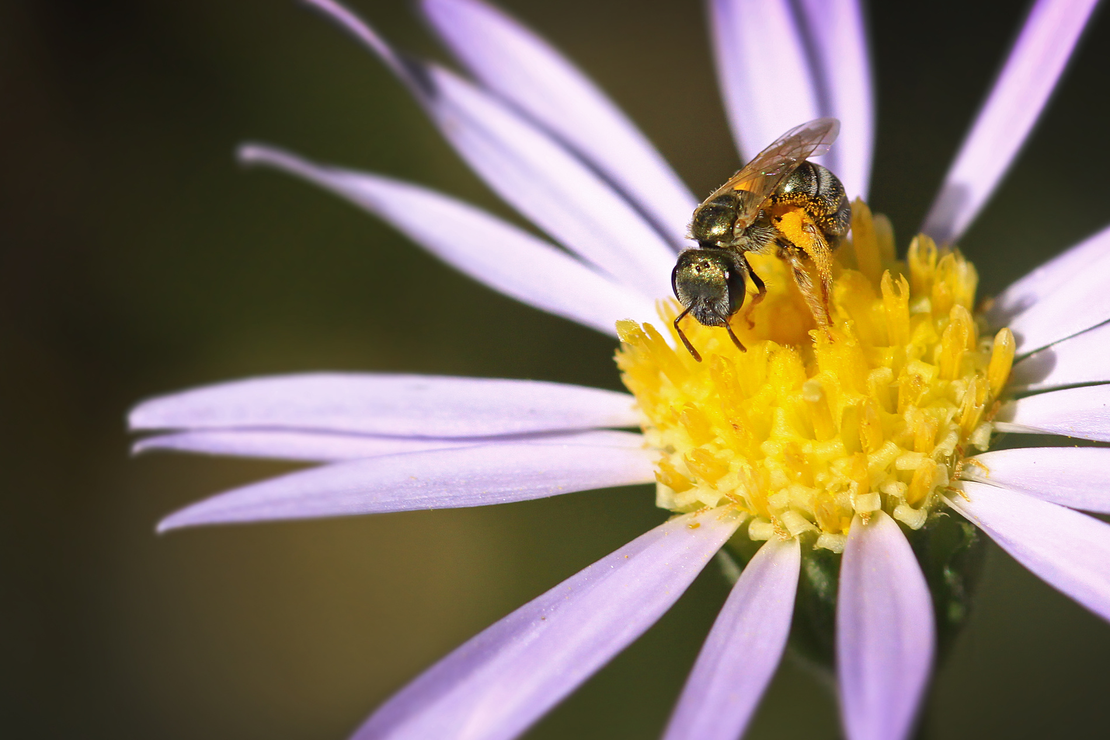
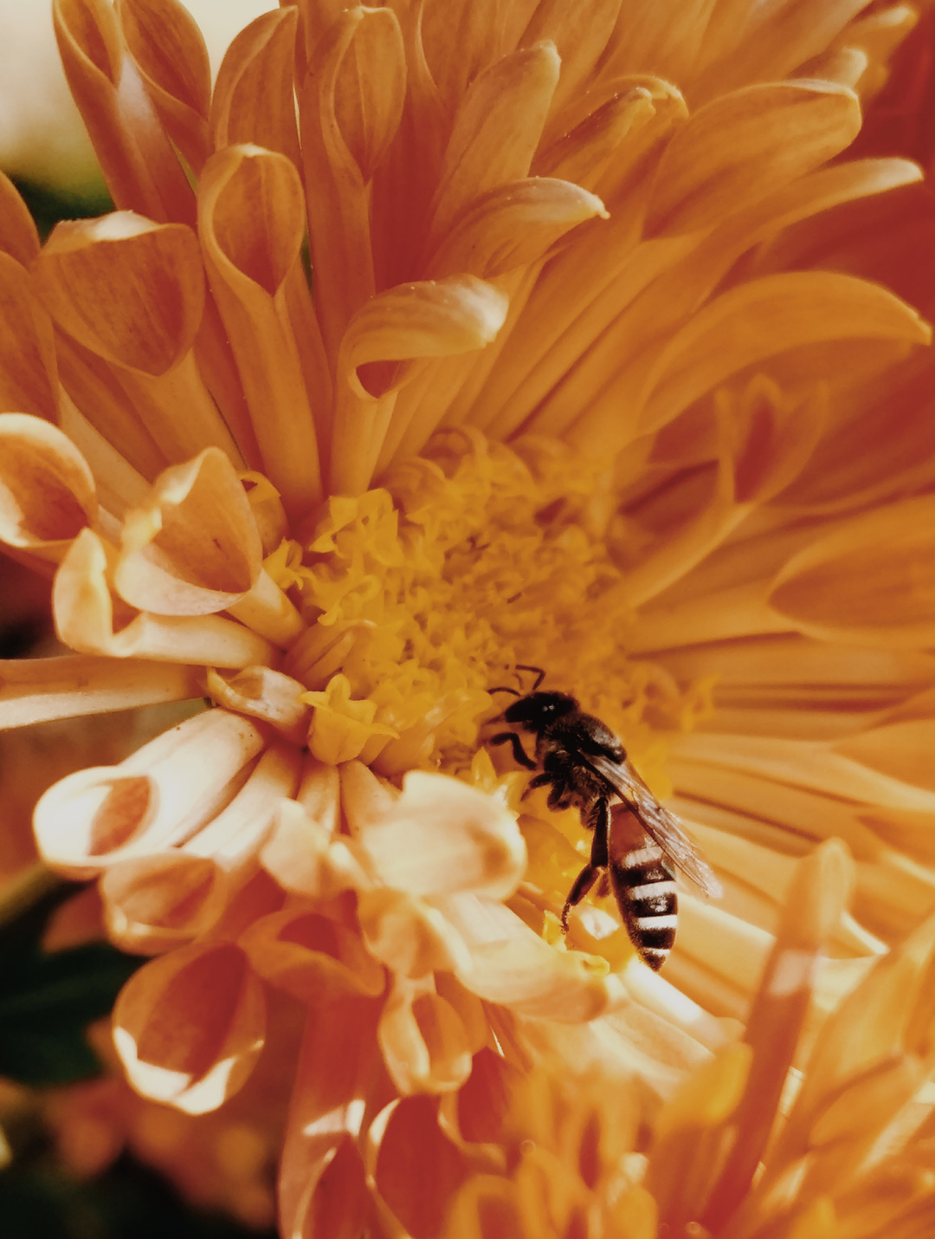



Our Solution
What is Jager ADS?
A multi-functional beehive defense and monitoring system that uses:
Camera feed to watch hive entrances in real-time
AI-powered classification to detect bees and threats
Mobile app that alerts when threats are detected

Slide 5

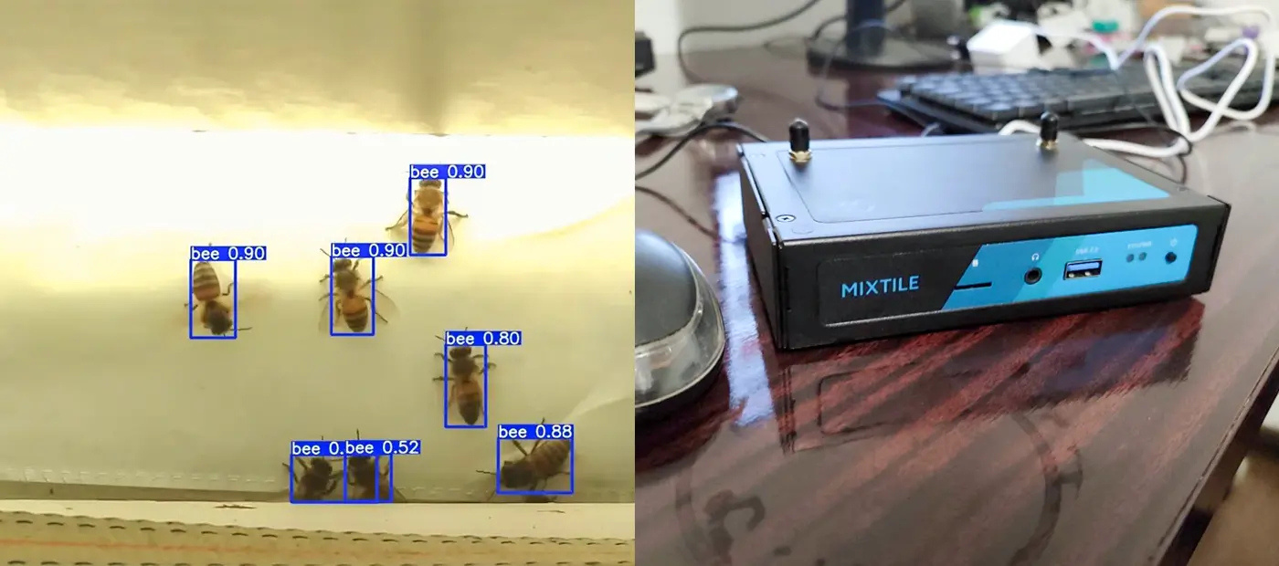
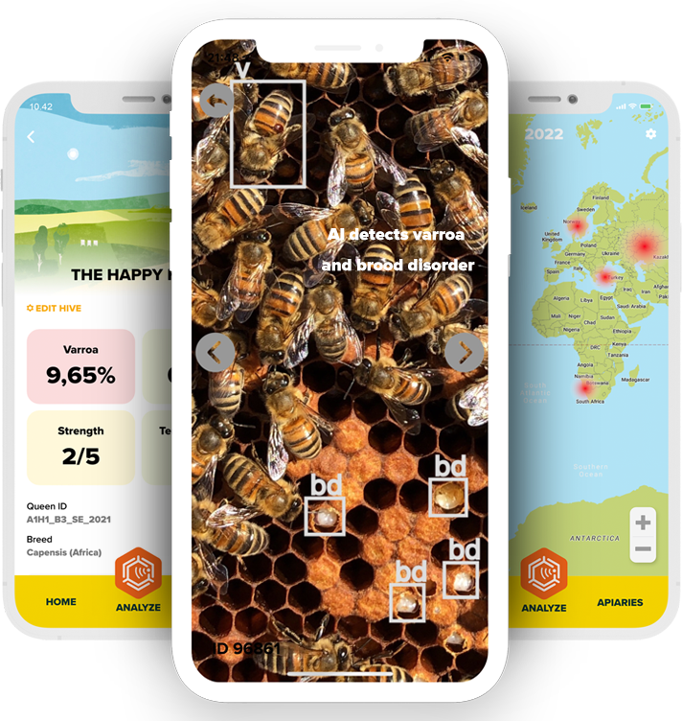
How It Works
Monitoring & Defense
Camera
Computer Algorithm
App Notification
Captures real-time video of hive entrance and it’s surroundings.
Processes each frame and classifies if an entity is a bee, threat, or anomaly.
Beekeepers get notified if a threat or unusual absence is detected.
Key Benefit:
Minimizes false alarms while saving both time and colonies.

Slide 6
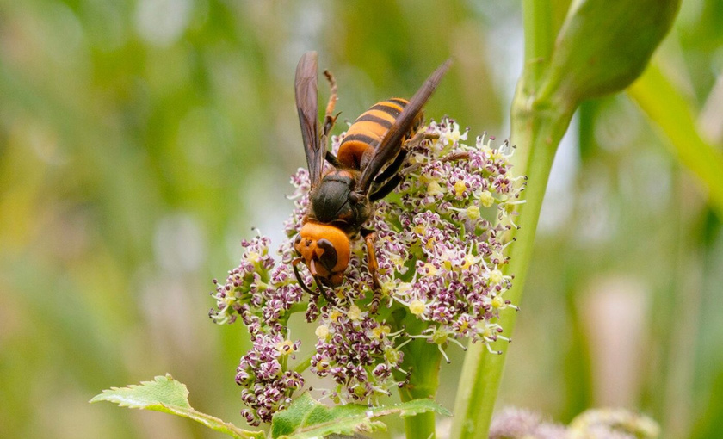
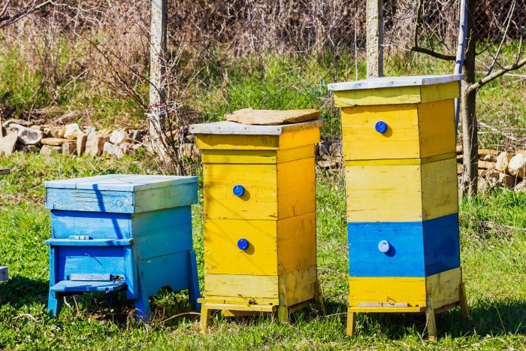
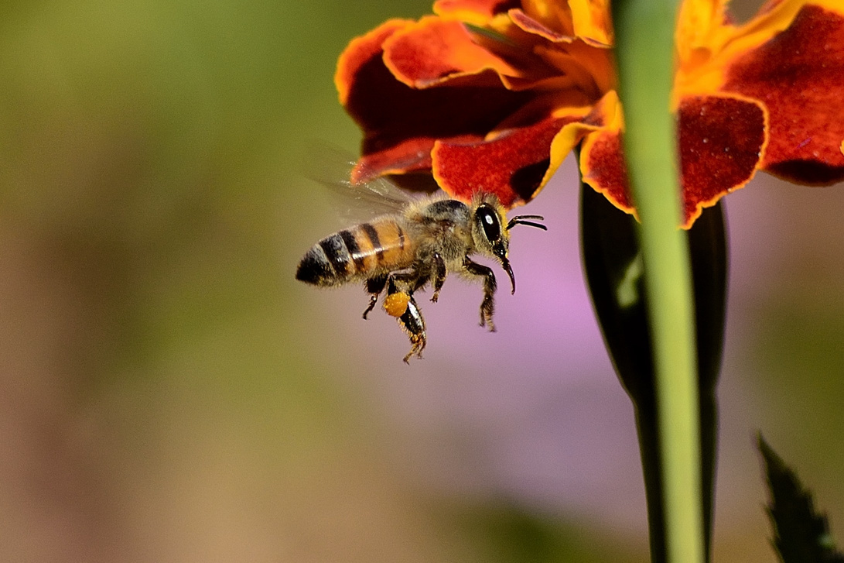
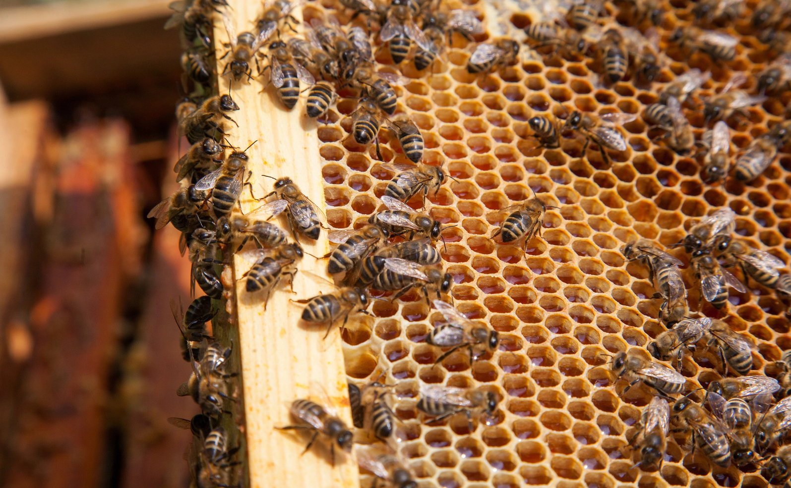
Key Features
Automated Alerts:
Instantly notifies user if threat detected
Scalable Design:
Works for backyard hobbyists or commercial farms
Real-Time AI Monitoring:
Classifies bee vs. predator in milliseconds
Non-Invasive Hive Support: Reduces manual checks, keeping bees undisturbed

Slide 7

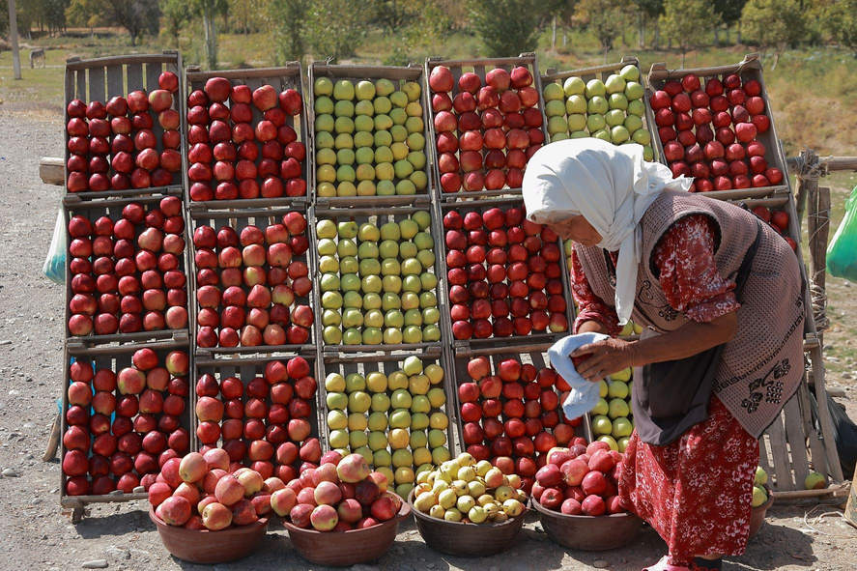
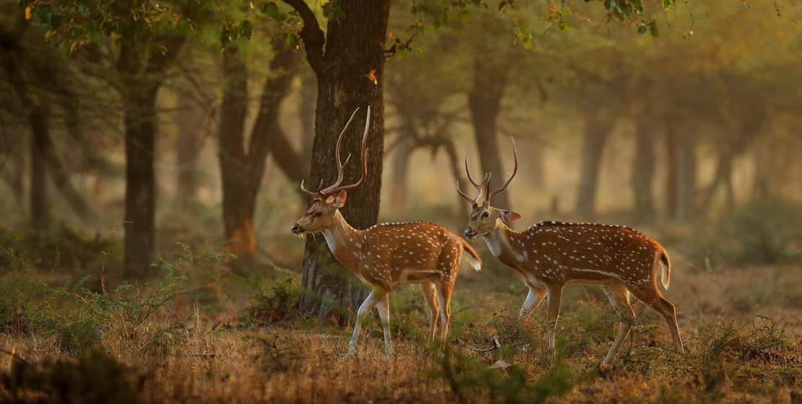
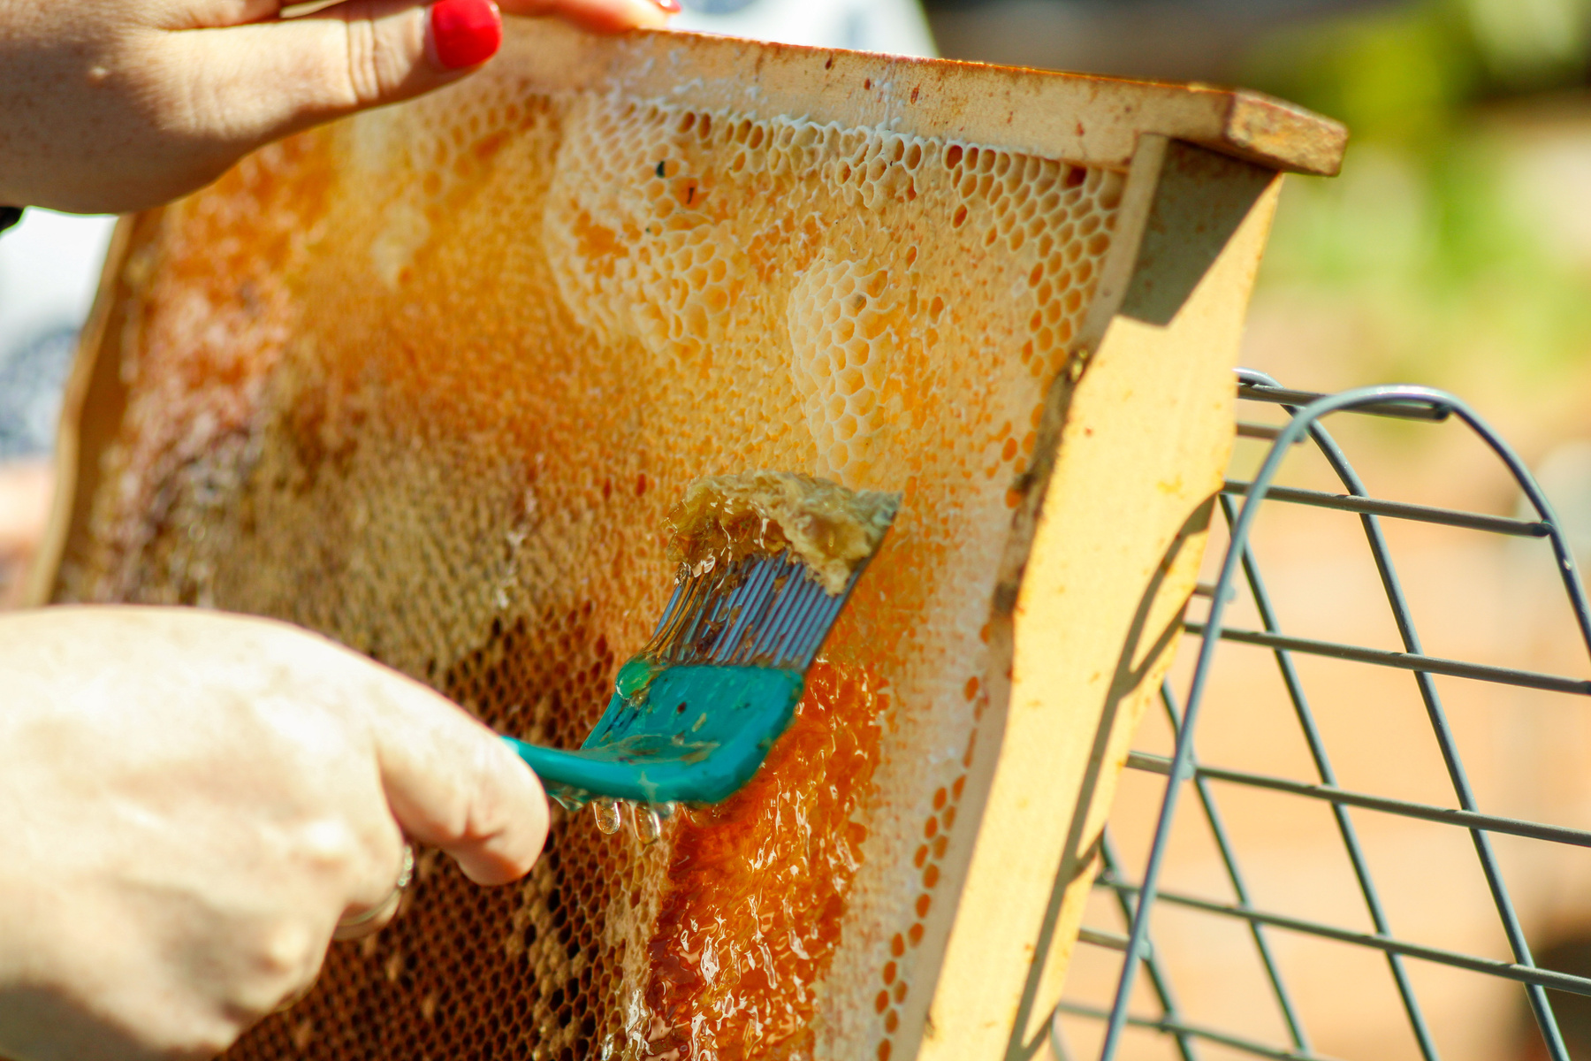
Impact & UN SDG Alignment
Primary Goal: Support beekeeping using smart, automated environmental tools.
Aligned SDGs:
SDG 13 – Climate Action
Bees as bio-indicators of environmental change
Real-time monitoring of ecosystem health
Climate Action
Zero Hunger
SDG 13
SDG 2
SDG 2 – Zero Hunger:
Supports agricultural productivity by protecting pollinators
SDG 15 – Life on Land:
Bees enhance biodiversity through wild plant pollination
Life on Land
Industry, Innovation & Infrastructure
SDG 15
SDG 9
SDG 9 – Industry, Innovation & Infrastructure:
Leverages AI and IoT for sustainable development

Slide 8
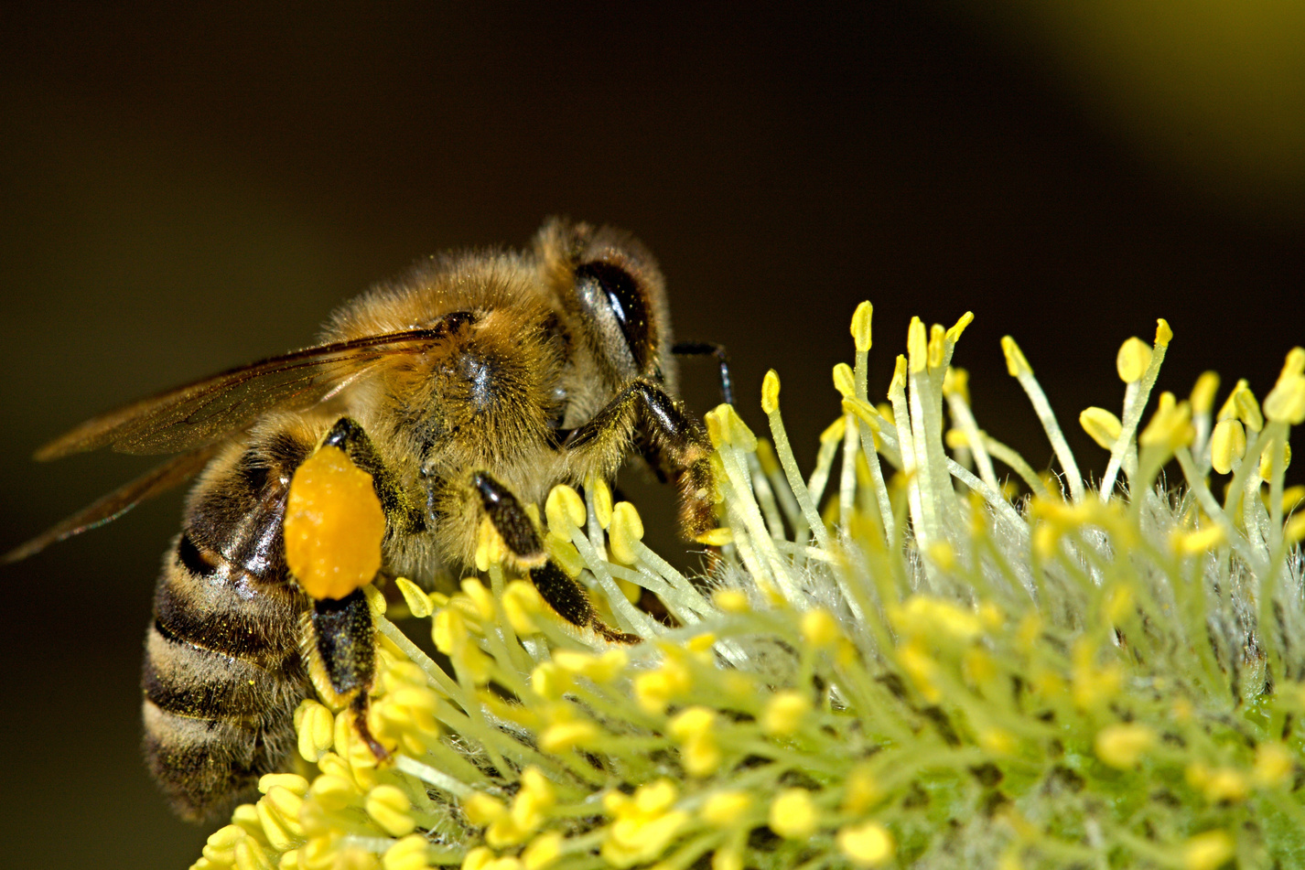
Technology Stack
Efficient, lightweight, and highly adaptable to different beekeeping environments.
Languages:
Python (backend), React Native (mobile app)
Machine Learning:
TensorFlow – CNN for object classification
Computer Vision:
OpenCV for image processing and detection
Backend Framework:
FastAPI for RESTful API communication

Slide 9
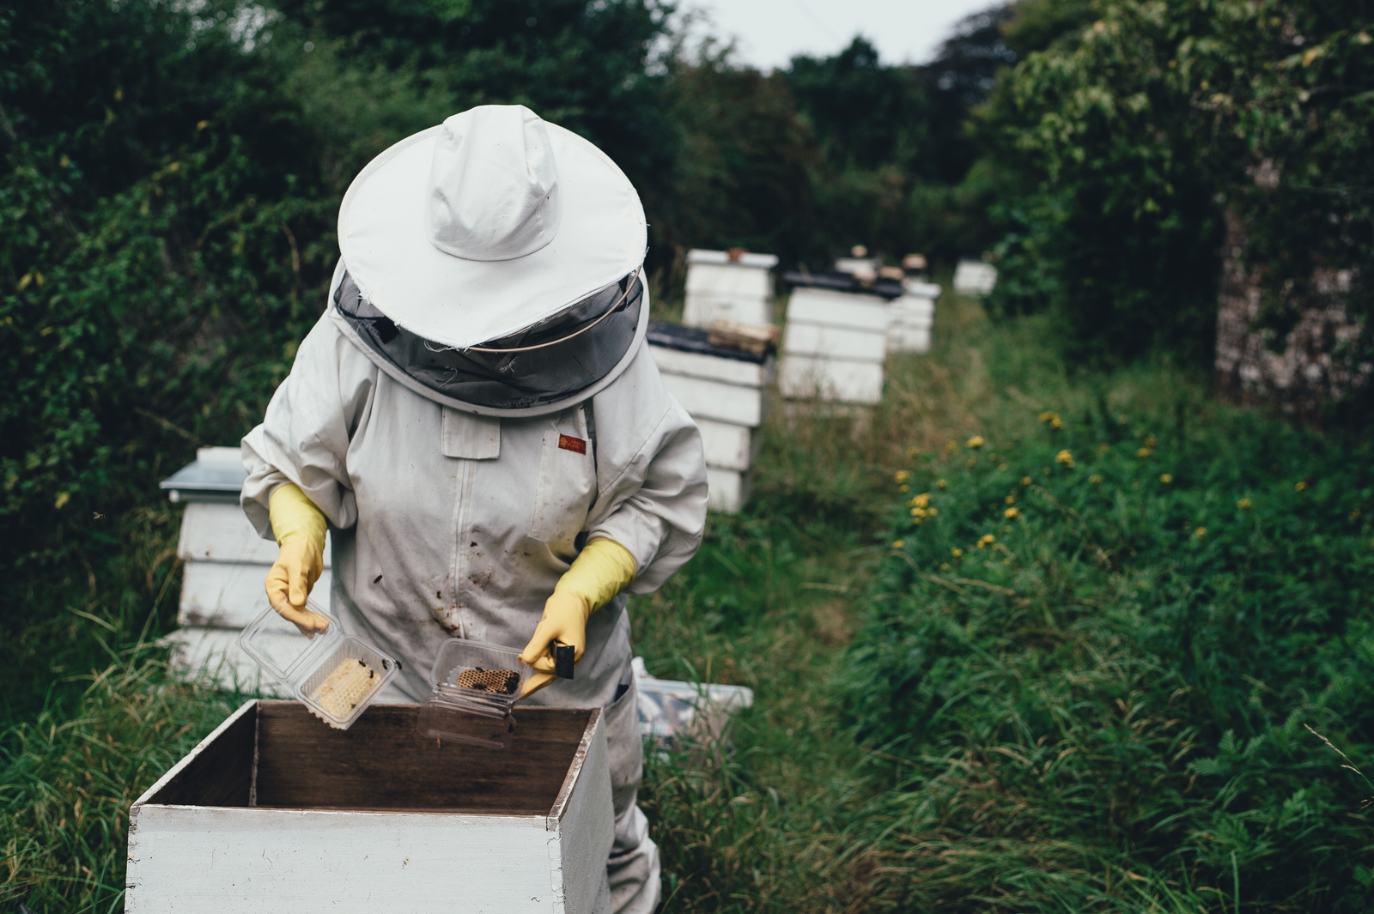
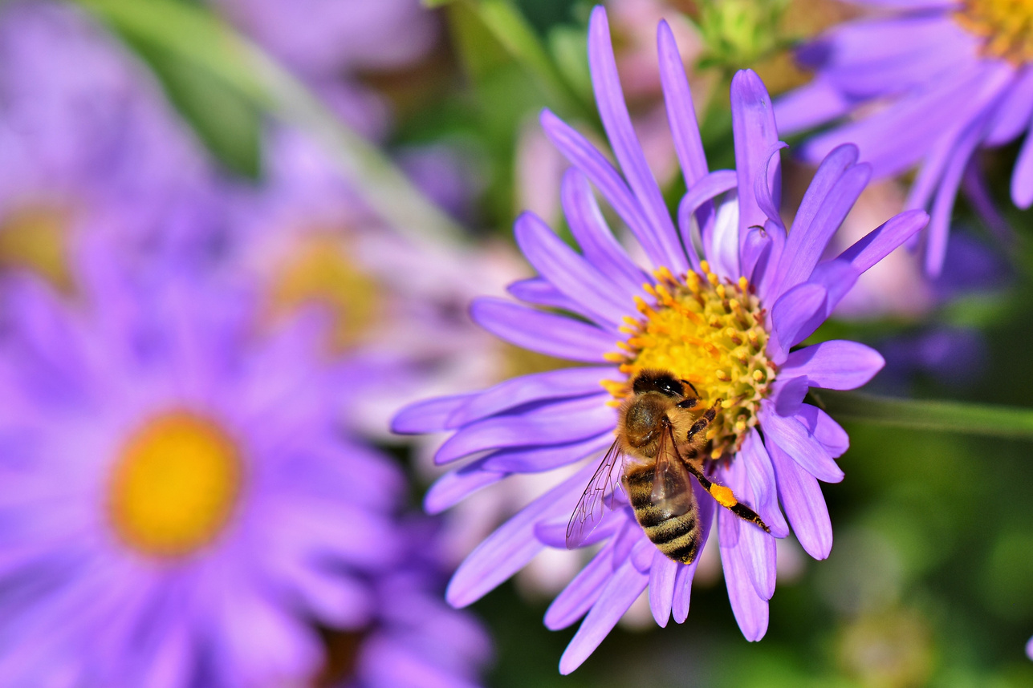
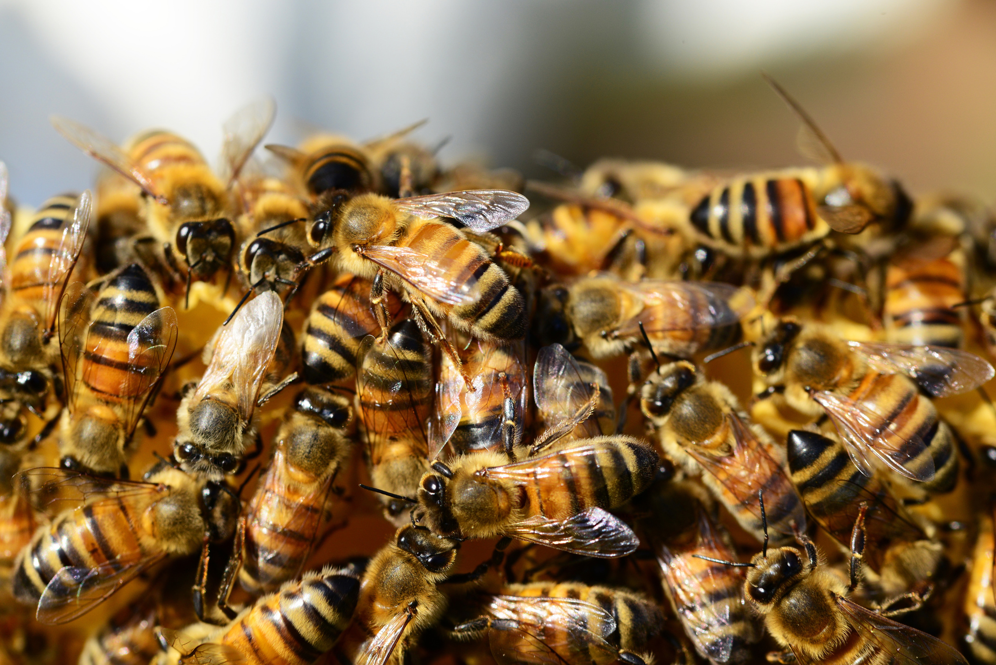
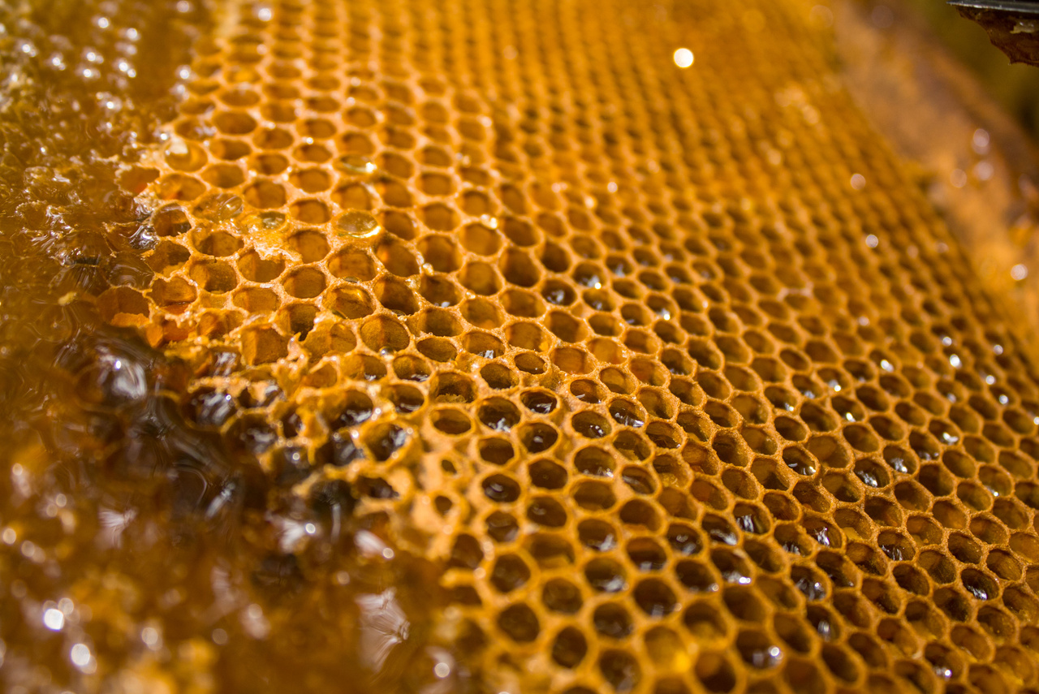
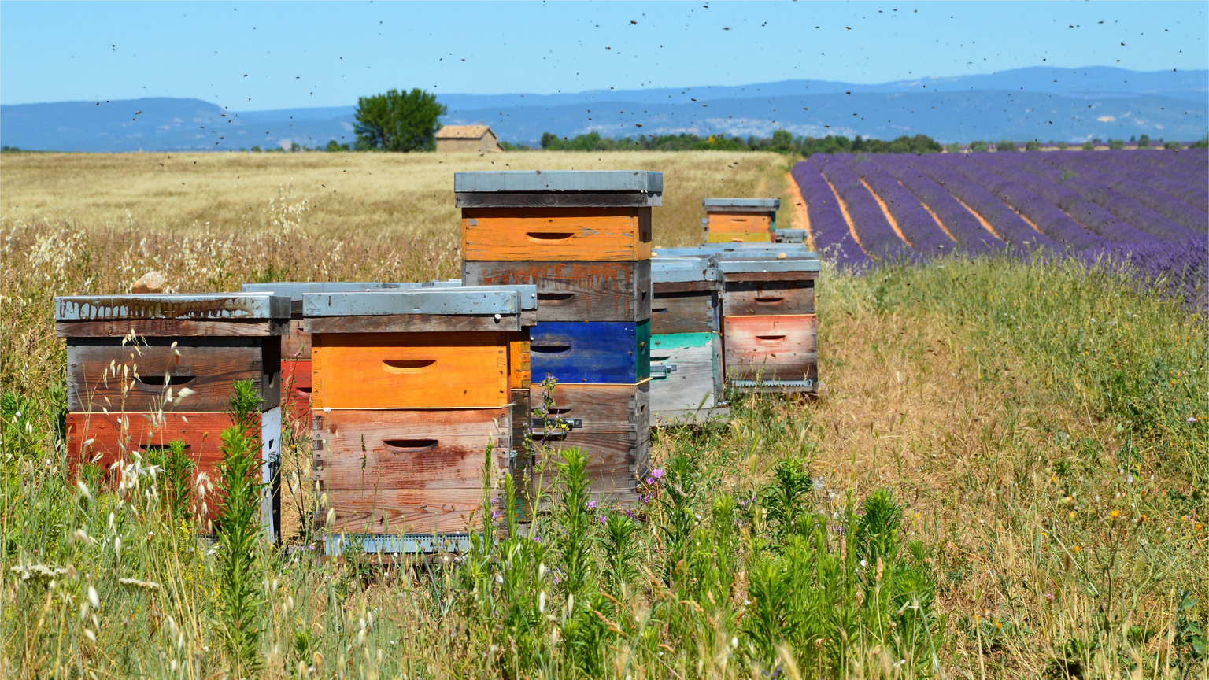
Future Development Roadmap
1) Advanced Classification:
Train on more detailed datasets to detect things like varroa mites, wax moths, queen activity indicators, and brood health issues.
2) Bee Counting:
Analyze traffic flow to estimate population and productivity.
3) Environmental Sensor Fusion:
Integrate temperature, humidity, and sound for full hive diagnostics.
4) Cloud Platform:
Aggregate hive data regionally to identify trends and anomalies.

Slide 10
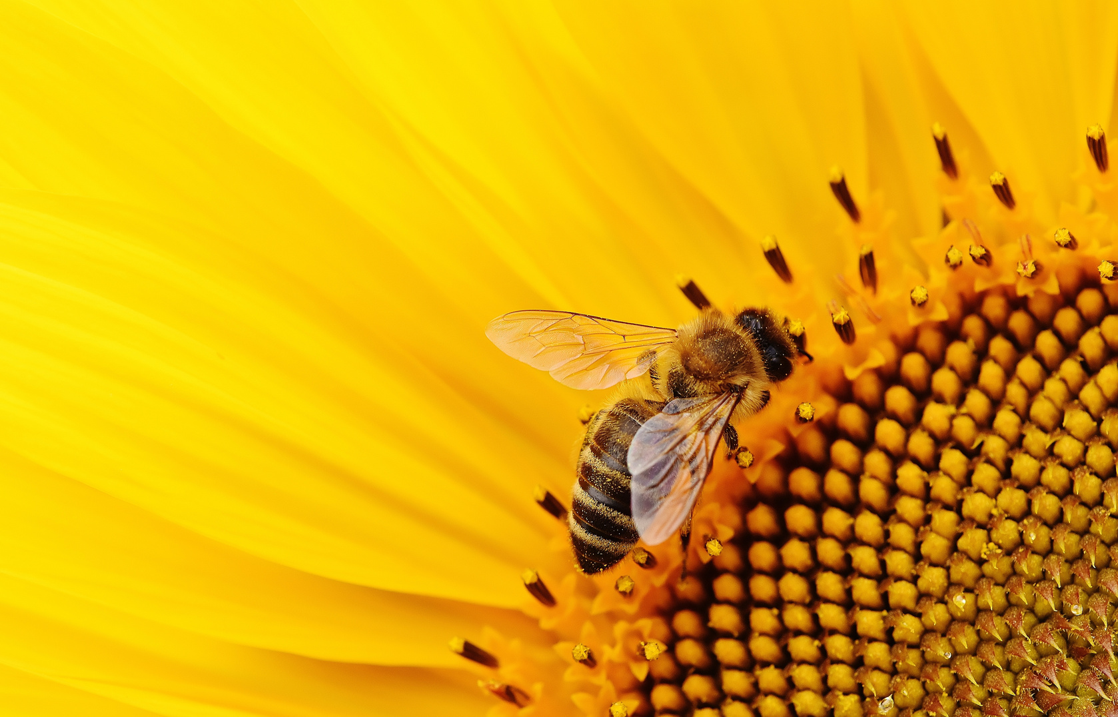
Why Jager ADS Matters
Protects bees at a critical time in environmental history
It's not just a defense system, it's a vision for resilient pollination.
Makes hive management more proactive and efficient
Reduces dependence on harmful chemicals for pest control

Slide 11
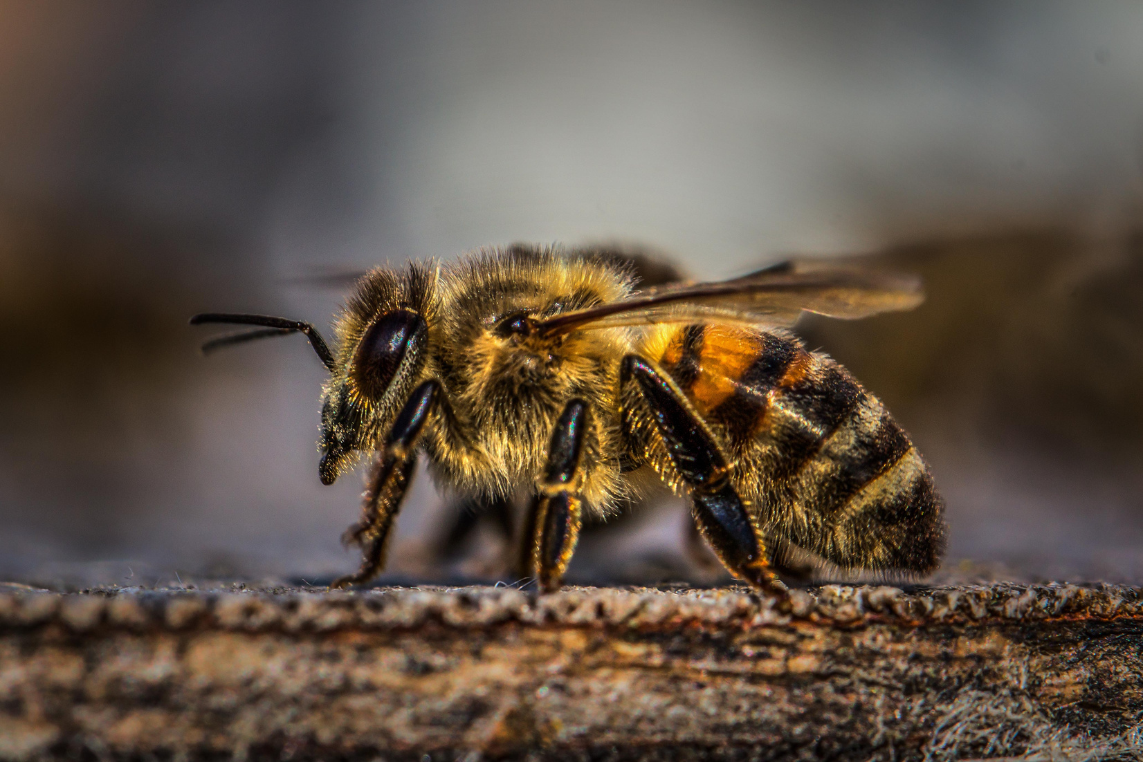
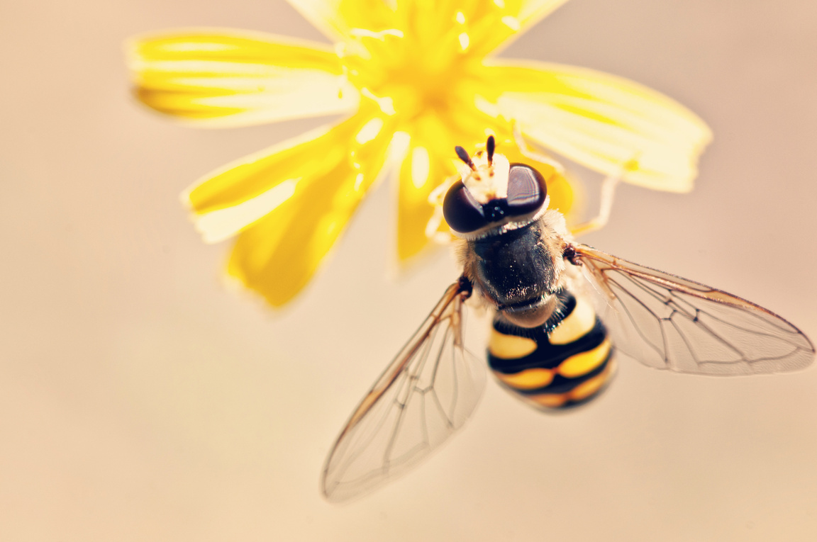
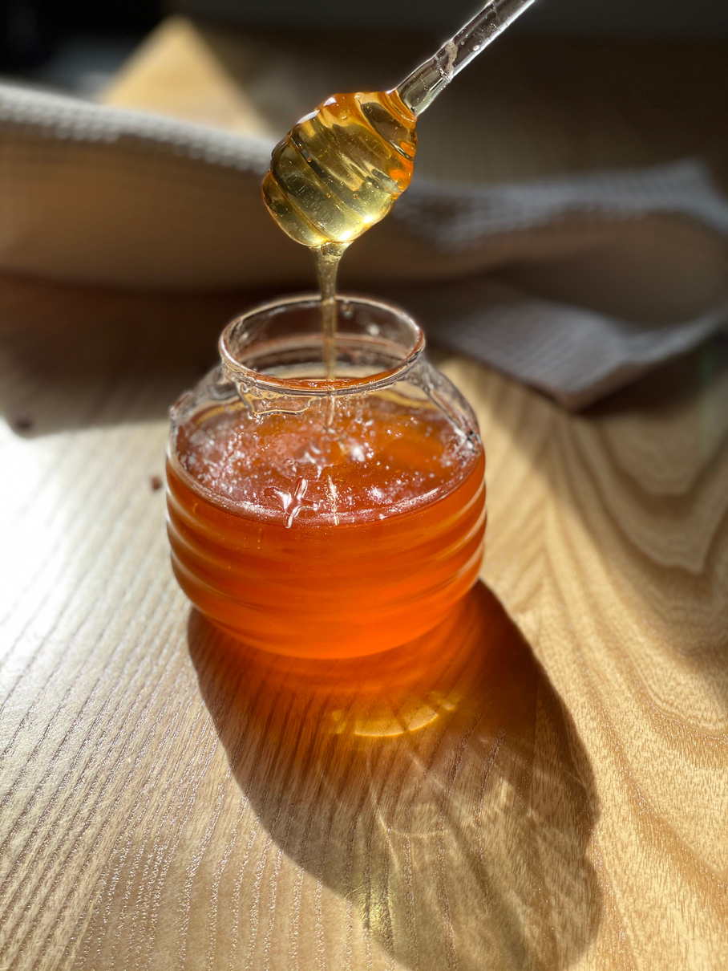
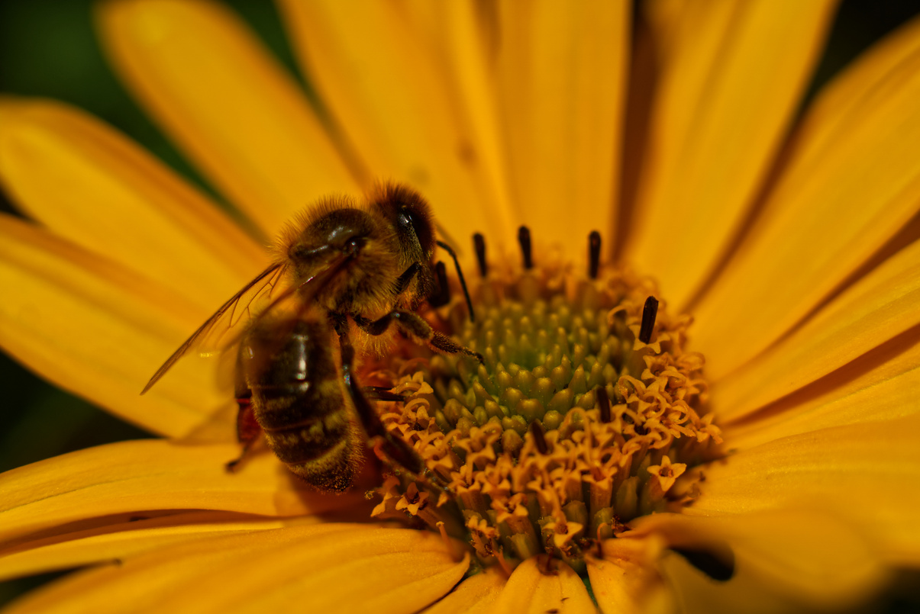
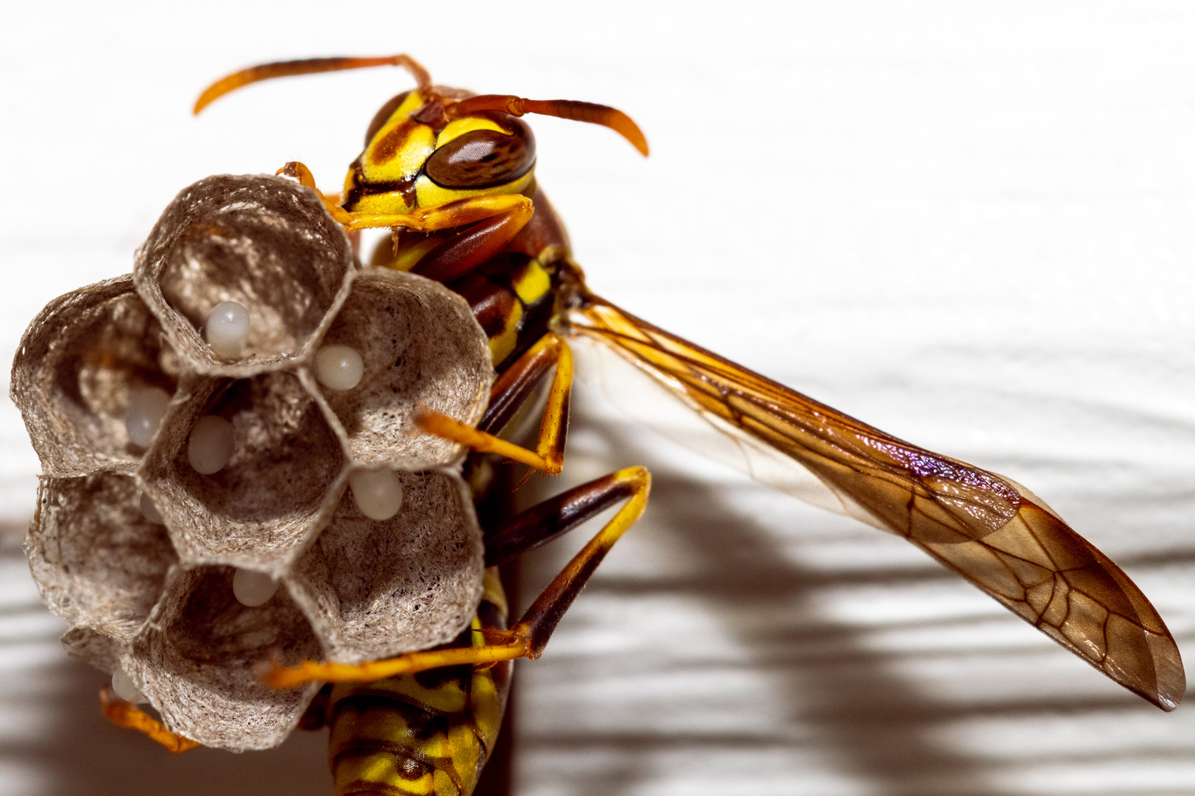
Thank You
Team Jager ADS

